Slide 1
Sales
Performance
Dashboard

Slide 2
OBJECTIVE
To monitor and analyze the sales performance.
To provide actionable insights for better decision-making.
To track key KPIs like revenue, profit, orders, customer trends.

Slide 3
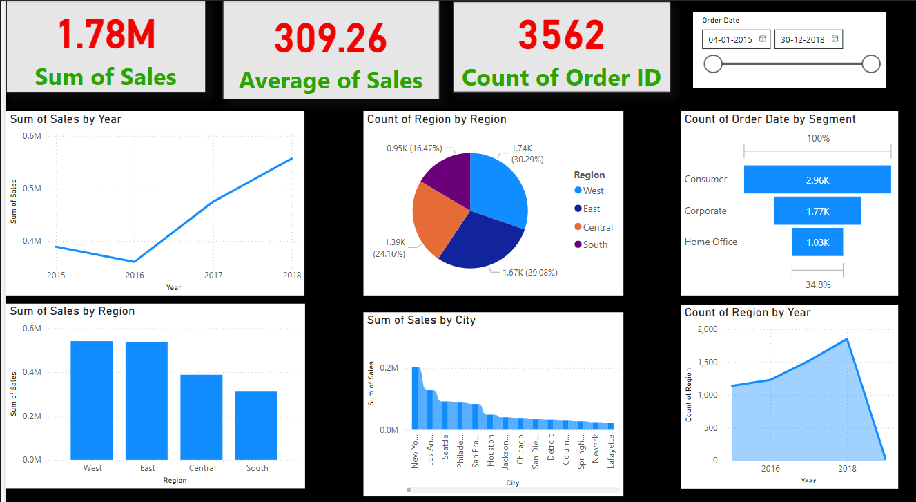

Slide 4
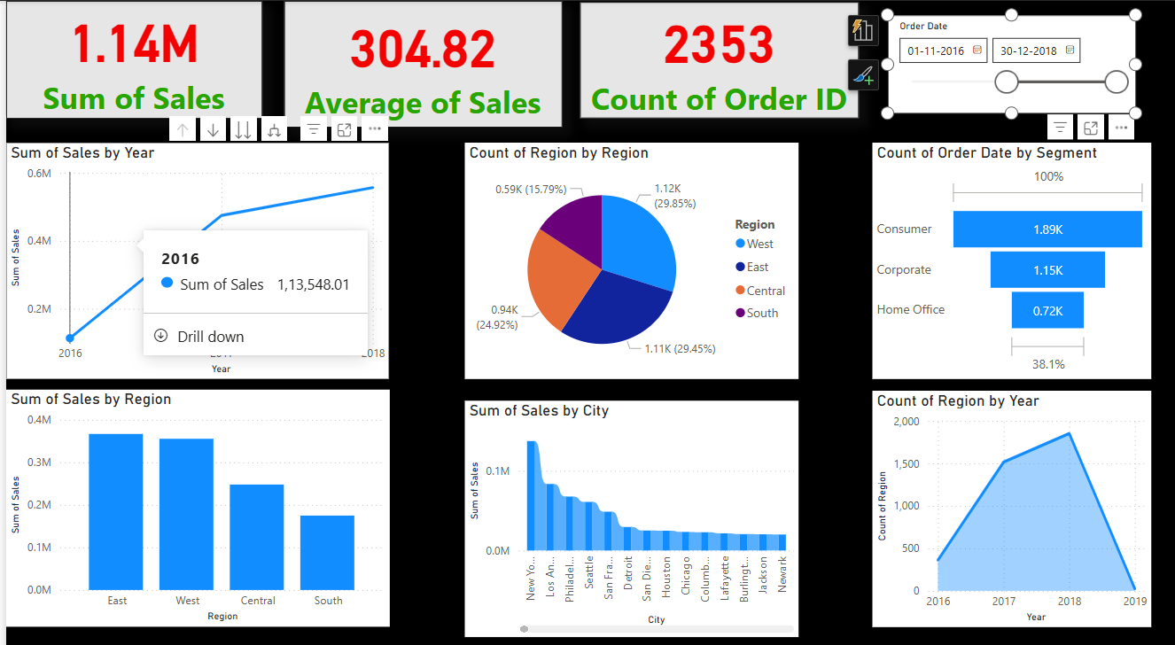

Slide 5
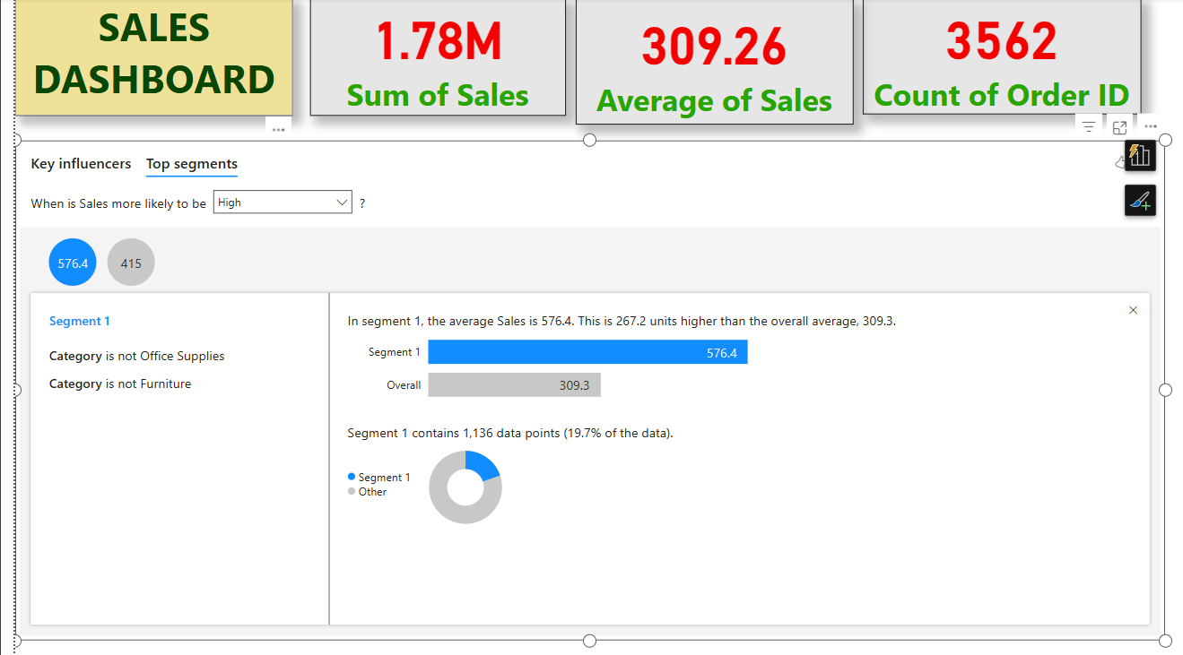

Slide 6
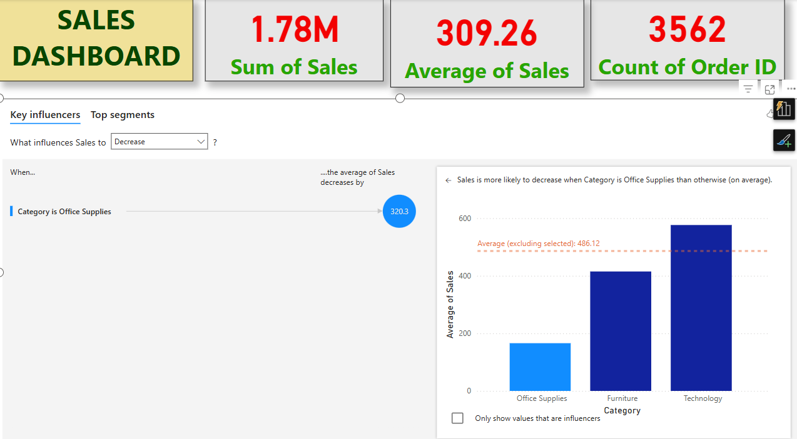

Slide 7
